Slide 1
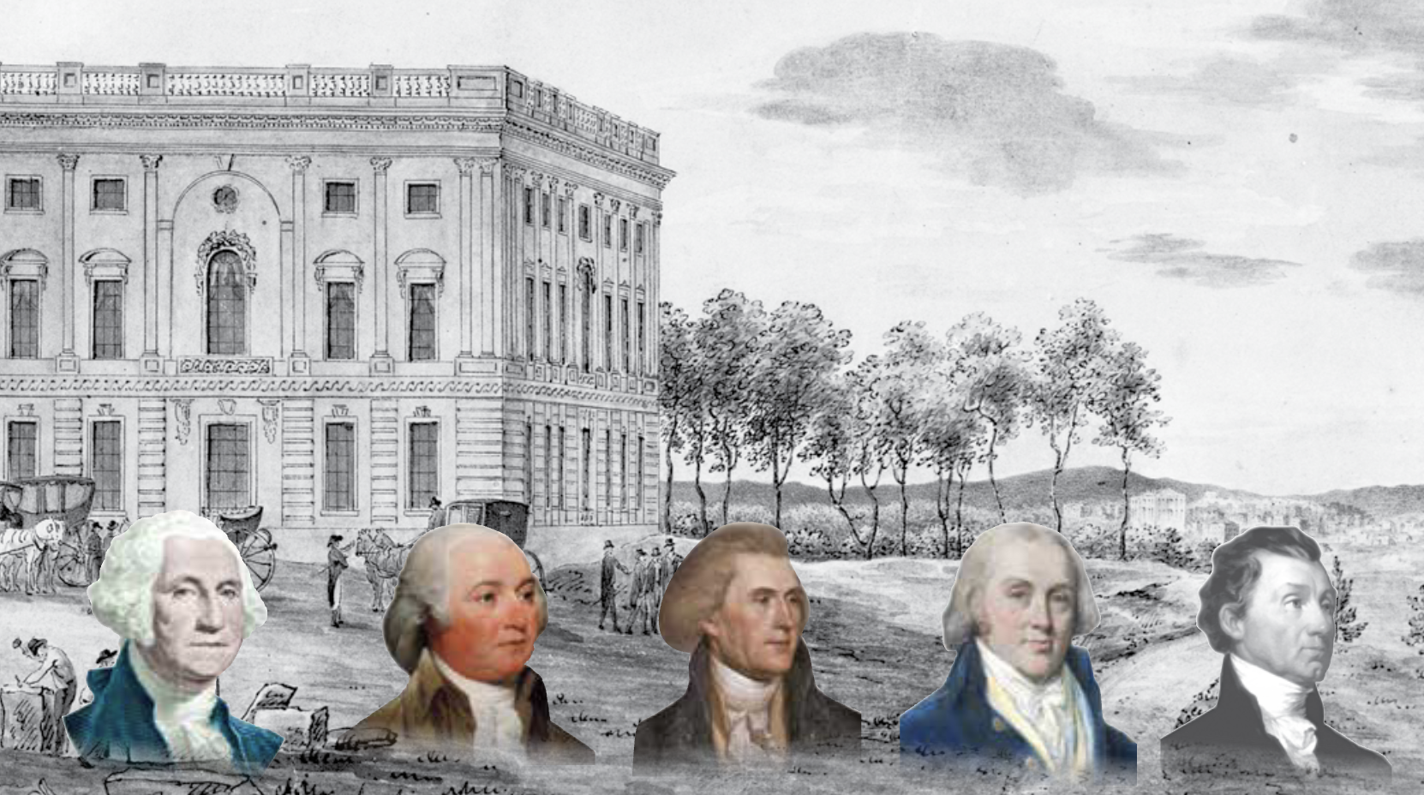
The First Presidents of the New Republic

Slide 3
Standards Covered in this Chapter
SSUSH6 What challenges were faced by our nation’s first five Presidents and how did they respond?
What events occurred during the Presidency of Washington and what precedents did he set?
What events occurred during the Presidency of John Adams, and how did the Alien and Sedition Acts influence the outcome of the election of 1800?
How did President Jefferson expand presidential power and how was the Louisiana Territory purchased and explored?
How did President James Madison conduct the War of 1812 and what was the war’s significance to the development of our national identity?
Why did President James Monroe issue the Monroe Doctrine?

Slide 4
Names and Terms You Should Know
George Washington
John Adams
Alexander Hamilton
Thomas Jefferson
Cabinet
Hamilton’s financial plan
Protective tariff
James Madison
Political party
Federalists
Democratic-Republicans
French Revolution
Whiskey Rebellion
Washington’s Farewell Address
Alien and Sedition Acts
Virginia and Kentucky Resolutions
“Revolution of 1800”
Napoleon Bonaparte
New Orleans
Louisiana Territory
Louisiana Purchase
Lewis and Clark
Blockade
Impressment
James Madison
War of 1812
“The Star-Spangled Banner”
Battle of New Orleans
James Monroe
Latin America
Monroe Doctrine

Slide 5
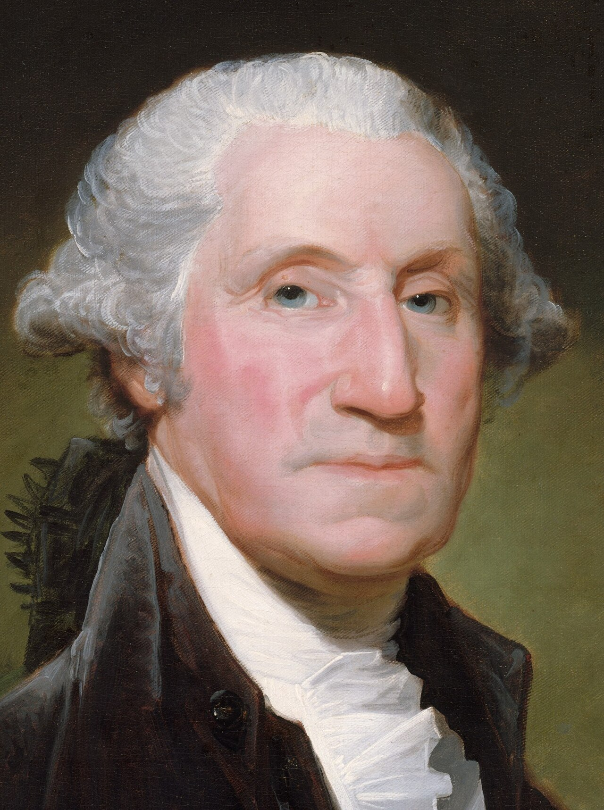
The Presidency of George Washington (1789–1797)
In 1788, George Washington was elected as the nation’s first President.
He faced many challenges.
Many of his actions would establish precedents—ways of doing things that would be copied in the future.

Slide 6
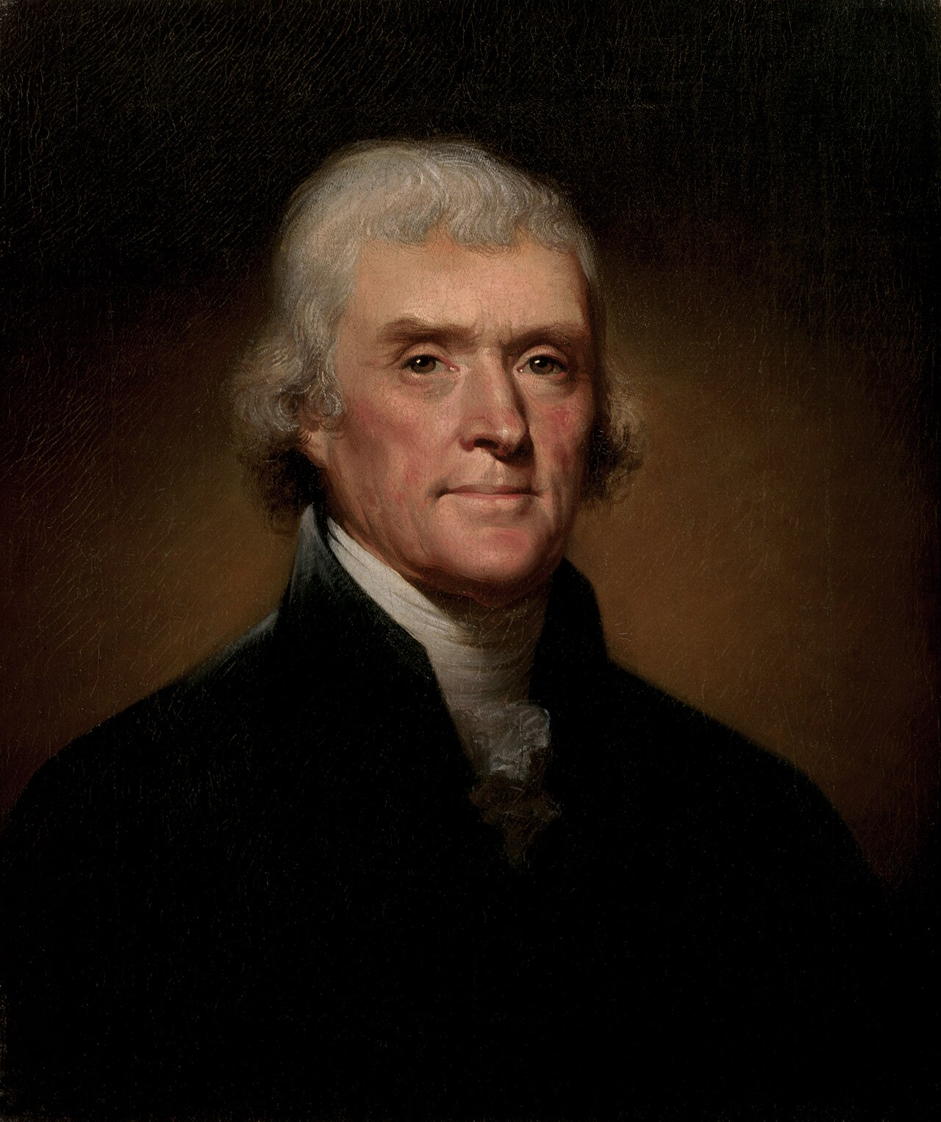
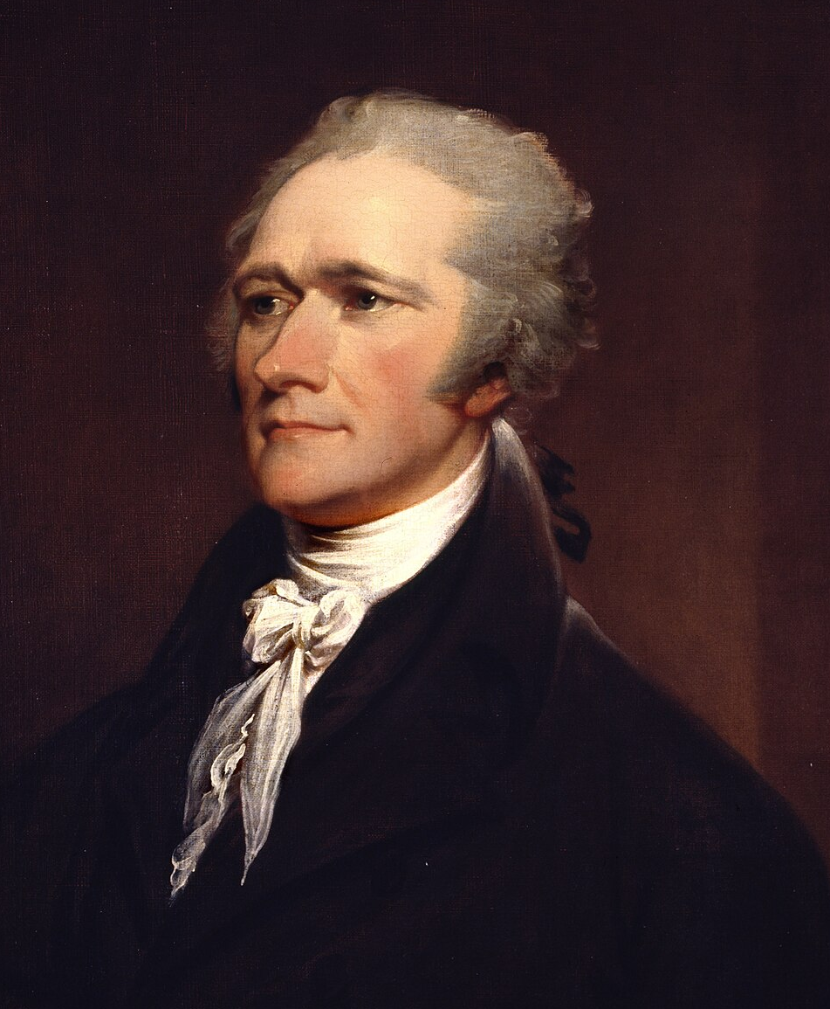
The Presidency of George Washington (1789–1797)
Washington established the Cabinet, made up of the appointed heads of government departments.
He appointed Thomas Jefferson as Secretary of State and Alexander Hamilton as Secretary of the Treasury.
The Cabinet held regular meetings, discussed issues, and gave advice.
Thomas Jefferson
Alexander Hamilton

Slide 7
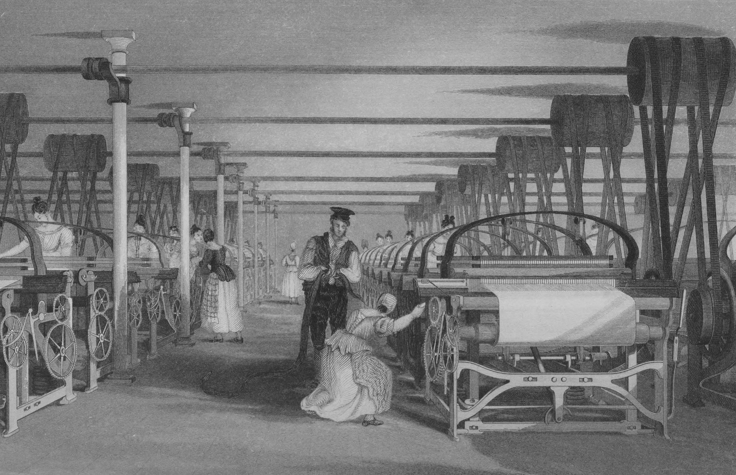
Hamilton’s Financial Plan
How a Tariff Works
Alexander Hamilton, Secretary of the Treasury, proposed a plan for dealing with the nation’s finances. He recommended the government issue interest-paying bonds to pay off its debts left by the Revolutionary War.
To pay the interest on the bonds, Hamilton further proposed a tariff on manufactured goods.
Imagine that cotton cloth from Britain costs $10 a yard. The same cloth from an American manufacturer costs $12 a yard. The British cloth is less expensive. But if a tariff of $5 a yard is added to the British cloth, it will cost $15 a yard. The American cloth is now cheaper.

Slide 8
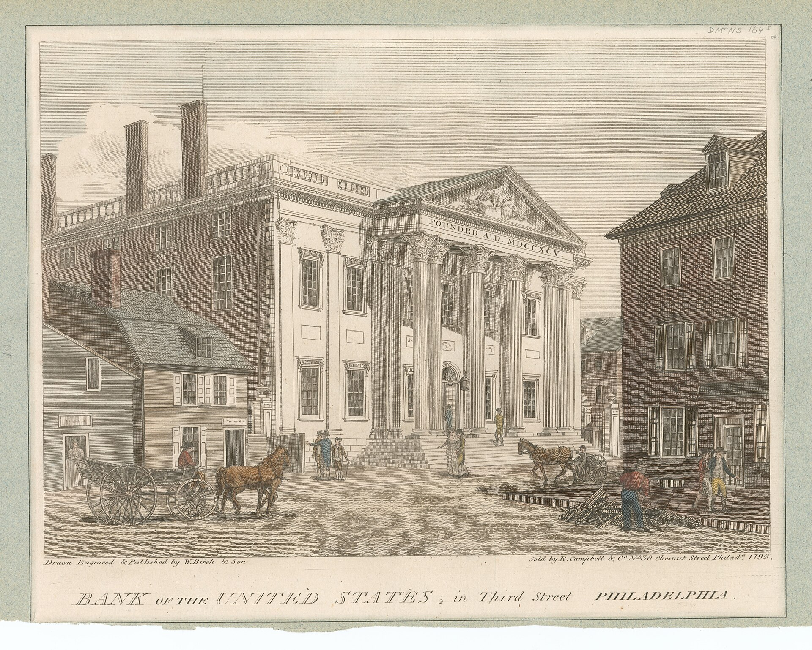
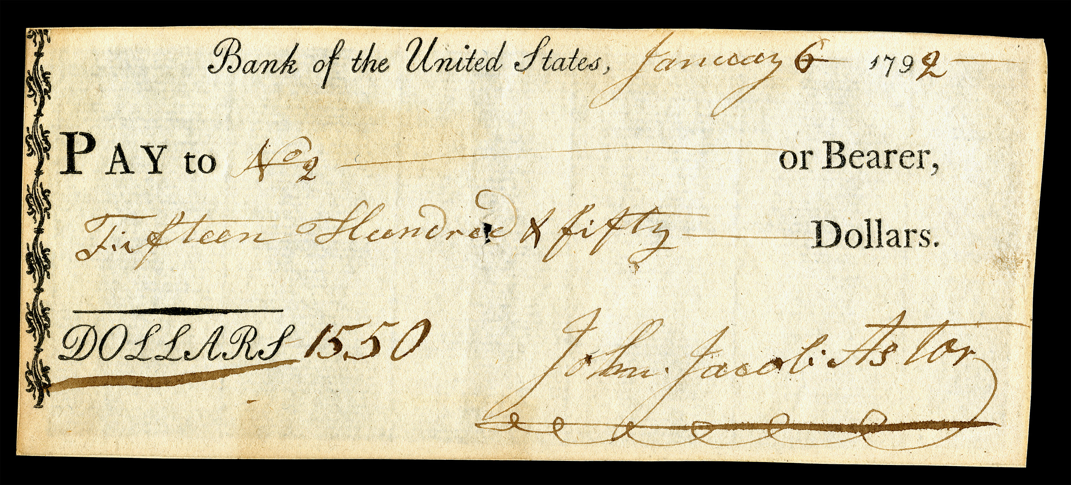
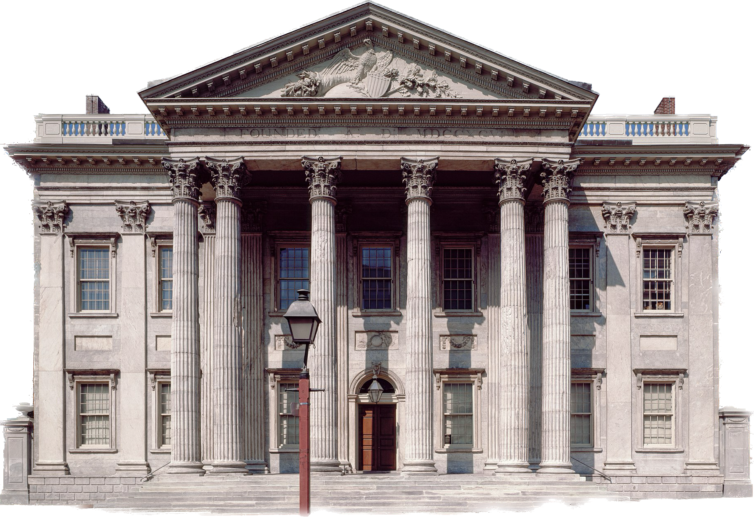
Hamilton’s Financial Plan
To help the government manage its revenues, Hamilton also proposed the creation of a national bank.
To raise additional funds for the federal government, Hamilton proposed a tax on whiskey.

Slide 9
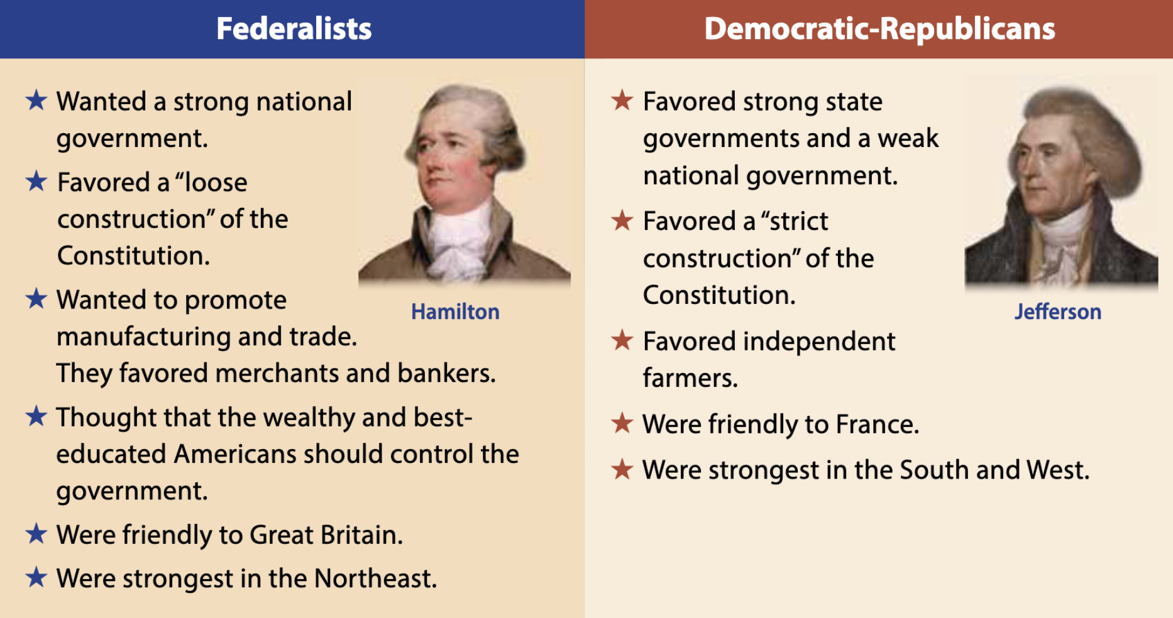
The First Political Parties
Jefferson and Madison opposed Hamilton’s plan, leading to the rise of the first American political parties.
Federalists supported Hamilton’s plan. Jefferson and Madison led the Democratic-Republicans, who opposed it.

Slide 10
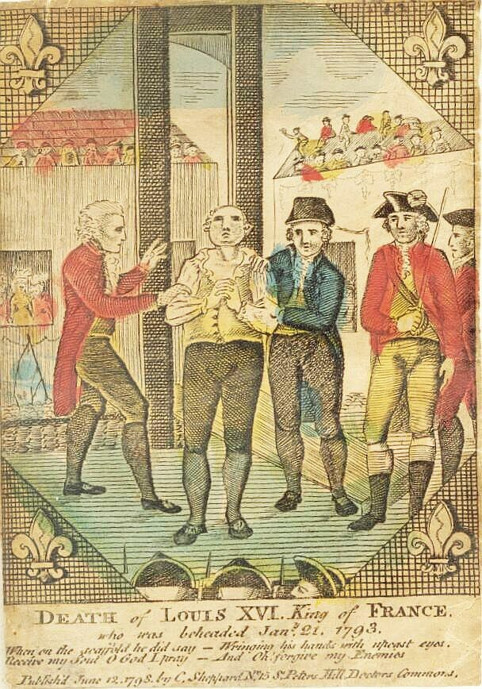
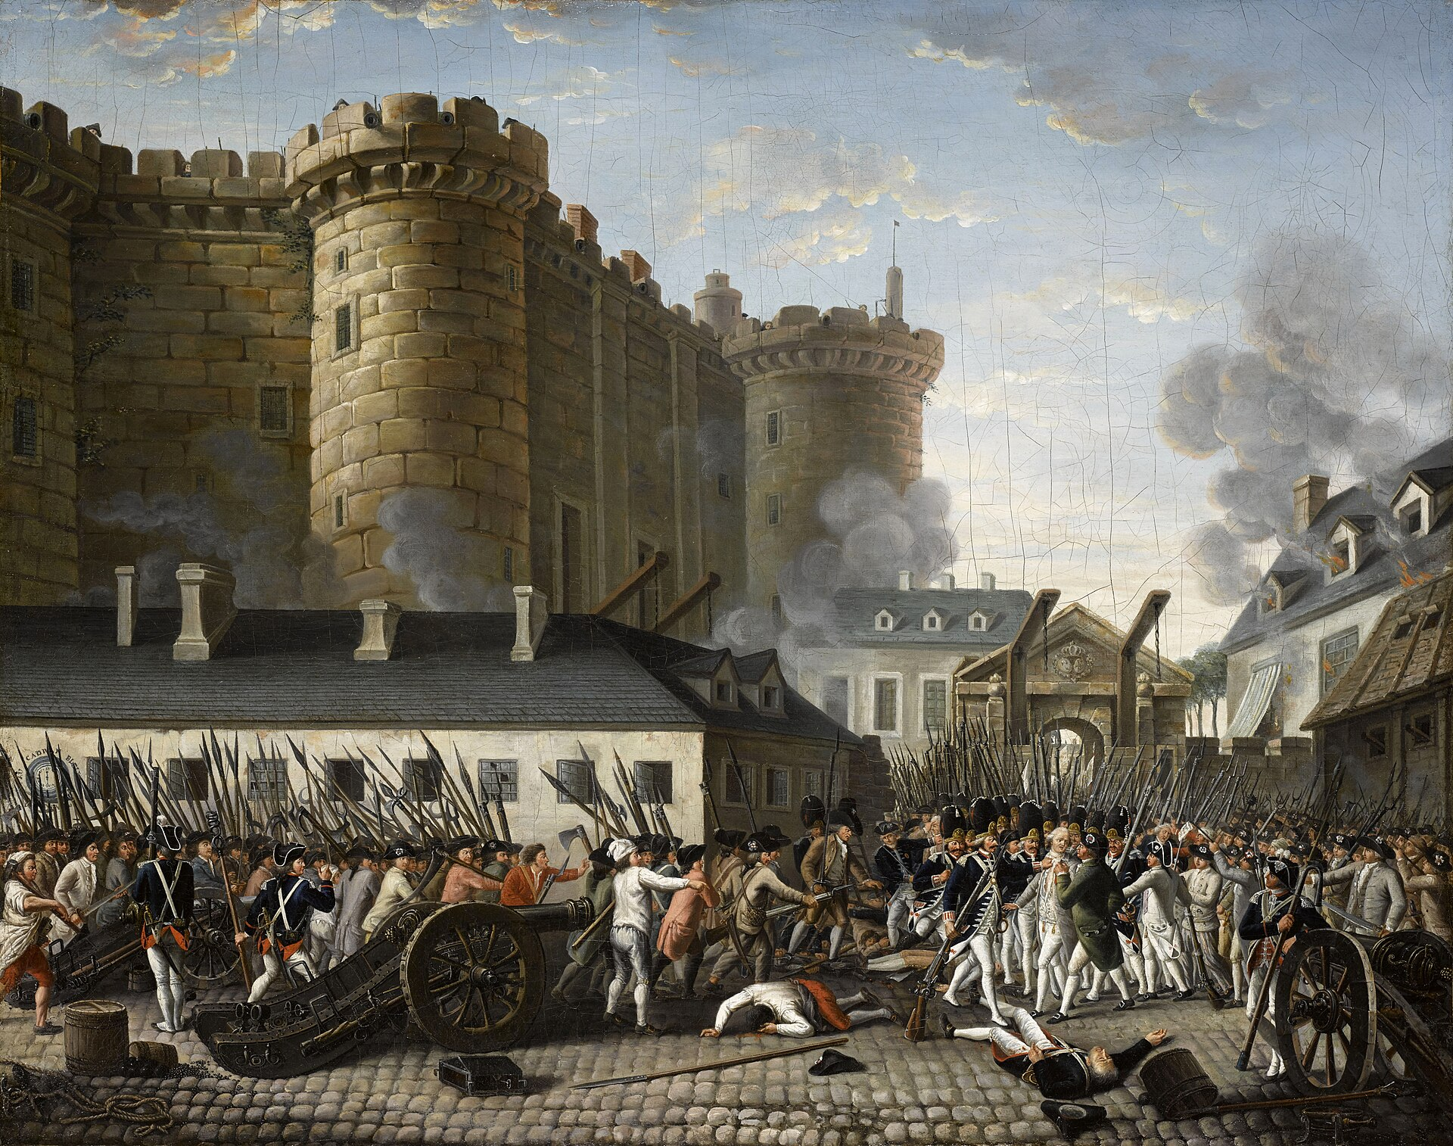
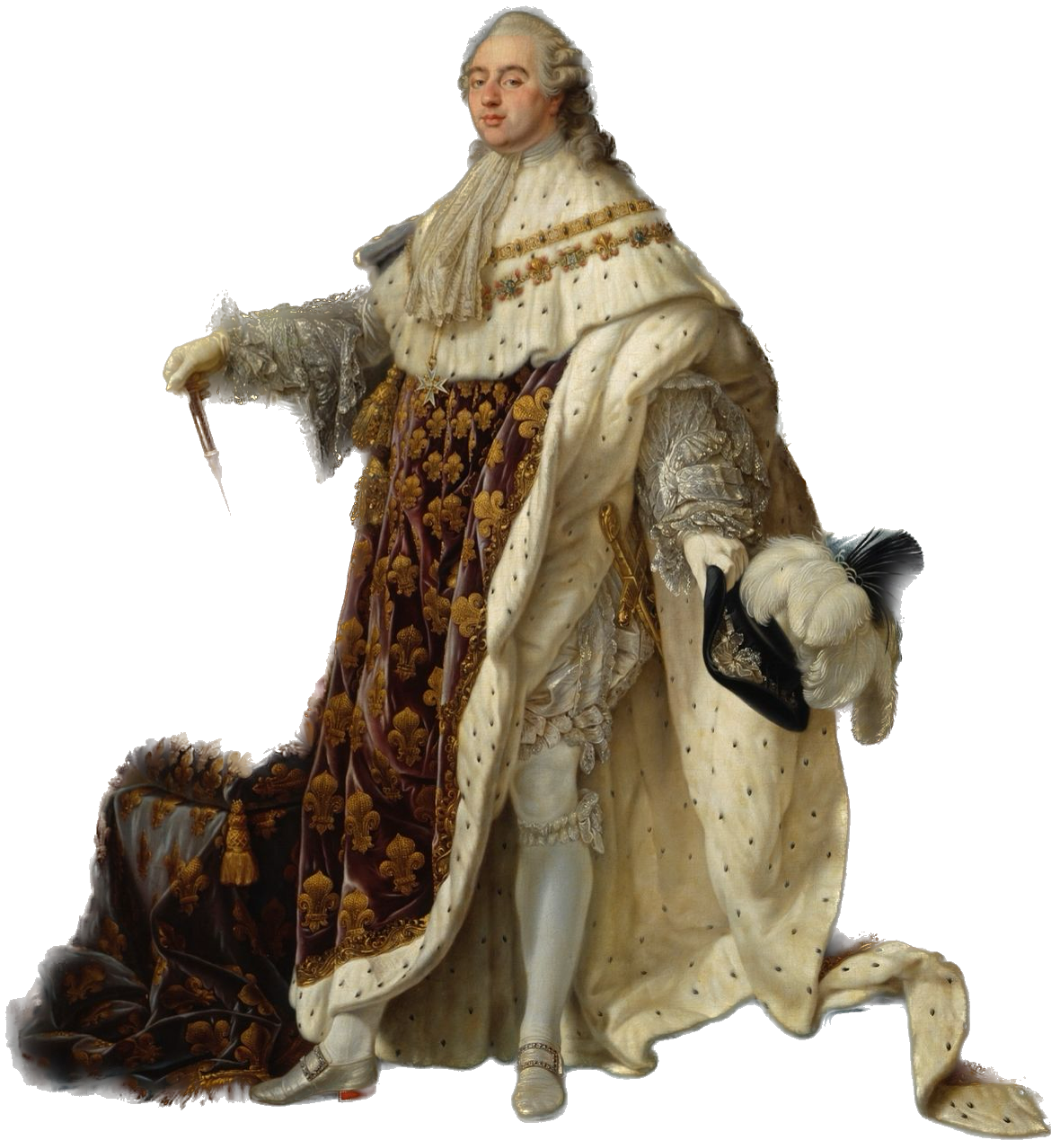
The French Revolution
While Washington was President, a revolution broke out in France. The French Revolutionaries executed the King and became involved in a war with Britain and the other powers of Europe.

Slide 11
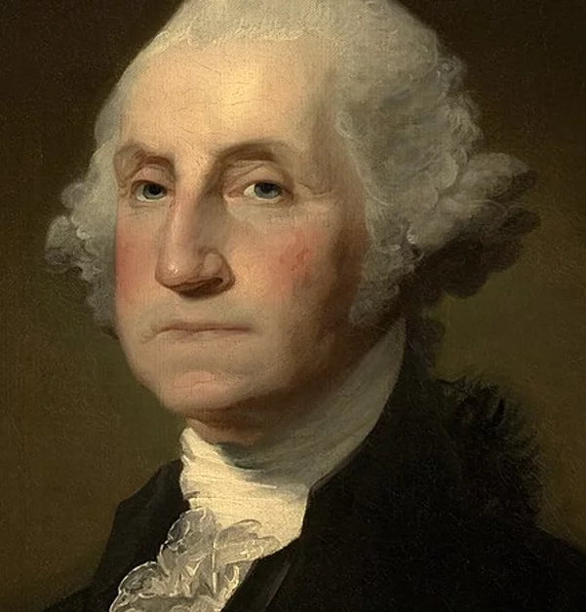
The French Revolution
Jefferson and the Democratic-Republicans remained friendly towards France. Hamilton and the Federalists favored Britain.
Washington declared in his Proclamation of Neutrality that the United States would remain neutral. It would be “friendly and impartial” to countries at war.

Slide 12
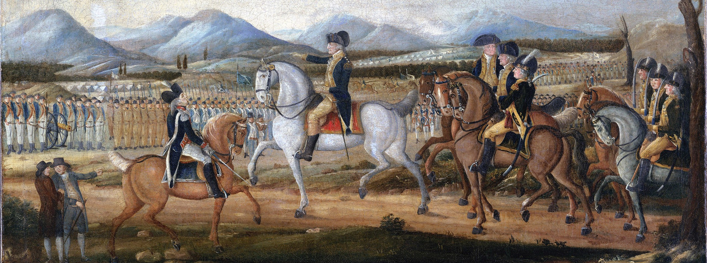
The Whiskey Rebellion
Farmers in western Pennsylvania rebelled against the whiskey tax. Washington and Hamilton led an army of 13,000 men against the “Whiskey Rebellion.” The rebels avoided a fight and returned home.

Slide 13
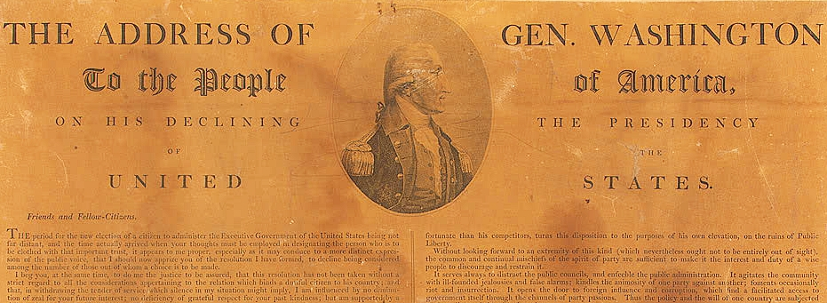
Washington’s Farewell Address
In his “Farewell Address,” Washington advised against political parties and warned about the dangers of entering into entangling alliances in Europe.

Slide 14
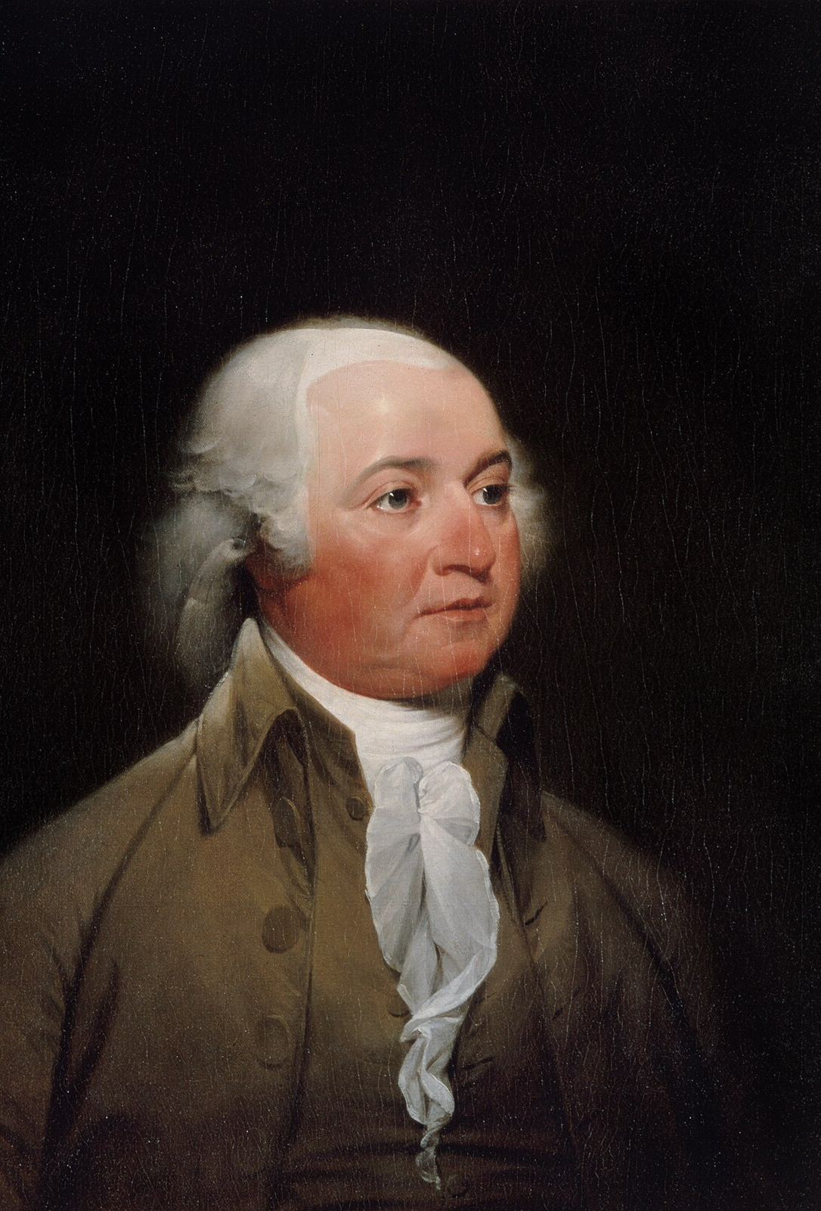
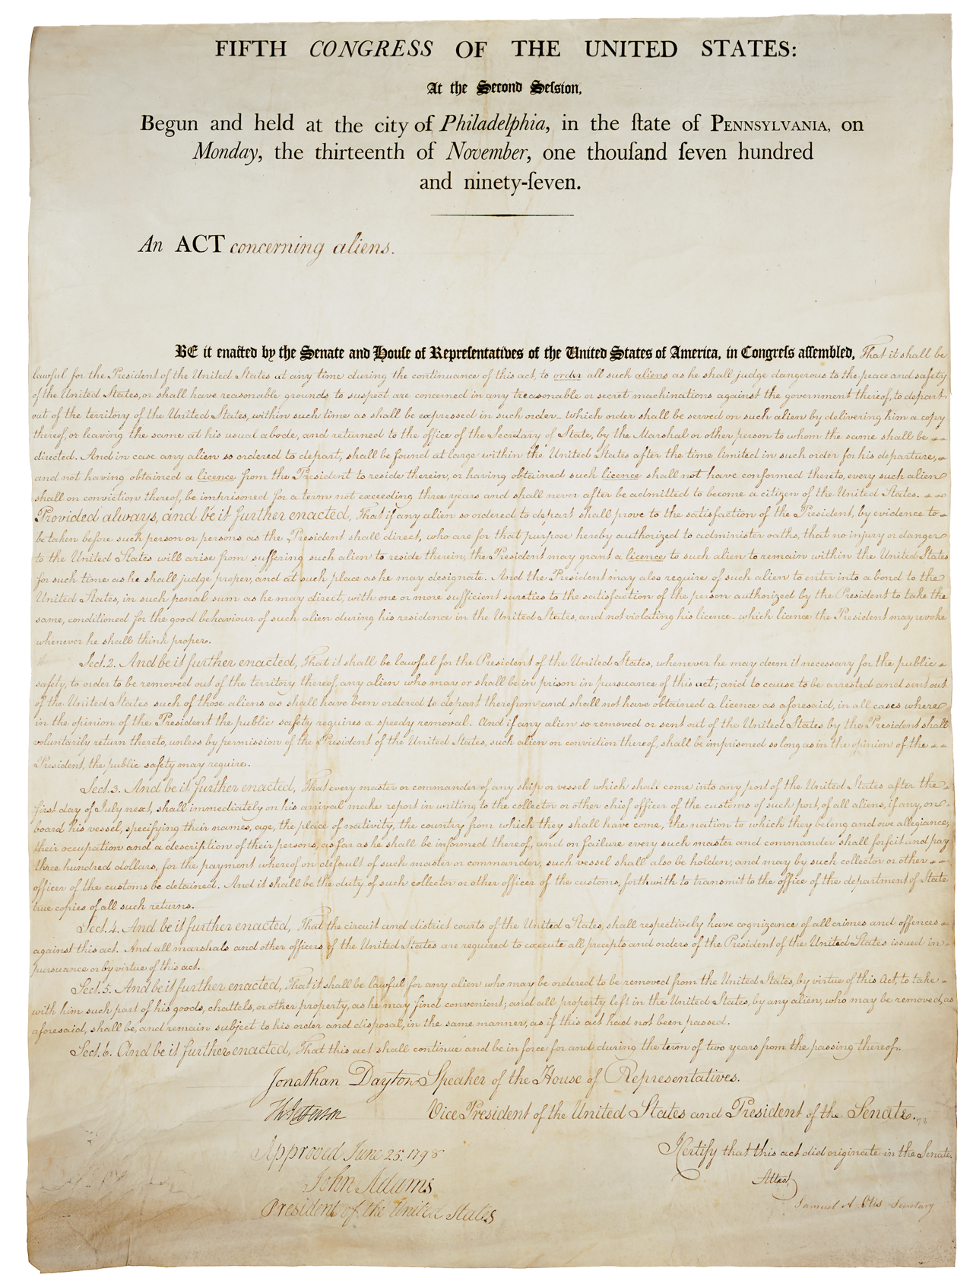
The Presidency of John Adams (1797–1800)
John Adams, a Federalist, was elected as our second President in 1796.
Adams worried about potential spies. Congress passed the Alien and Sedition Acts, which gave him the power to send any foreigner out of the country, to imprison foreigners whose country was at war with the United States, and to fine or imprison anyone who spoke or wrote against the government. Madison and Jefferson believed these acts were unconstitutional.

Slide 15
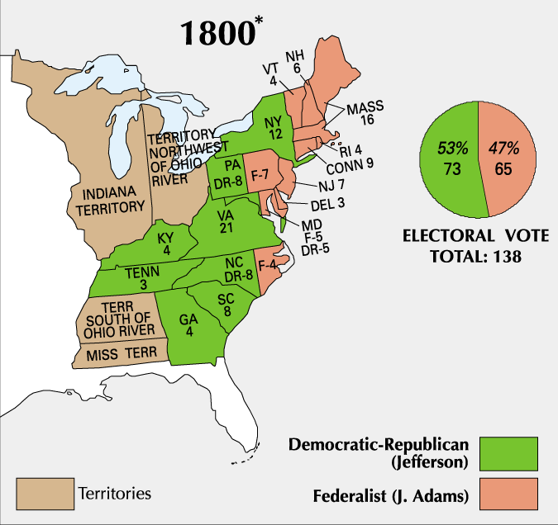
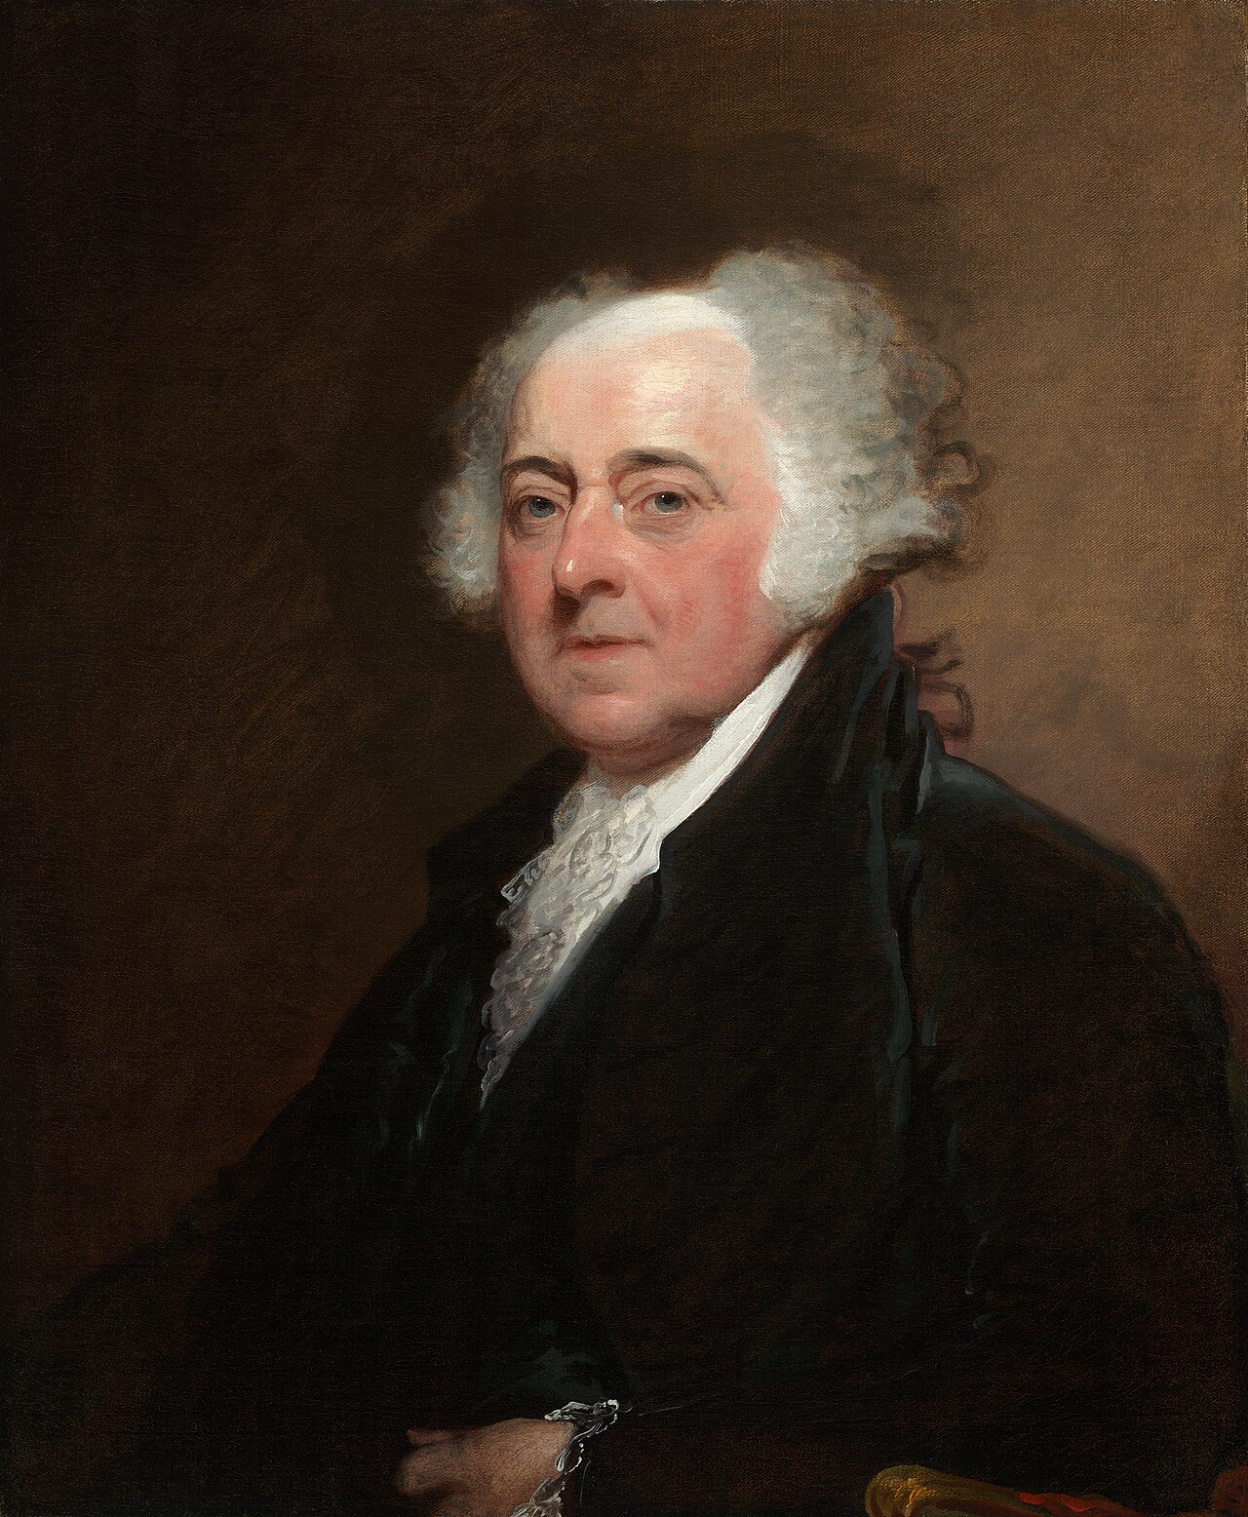
The Election of 1800
The Alien and Sedition Acts made Adams unpopular and cost him the next Presidential election.
Jefferson considered his election victory the “Revolution of 1800” because power peacefully passed between opposing political parties.
Thomas Jefferson
John Adams

Slide 16
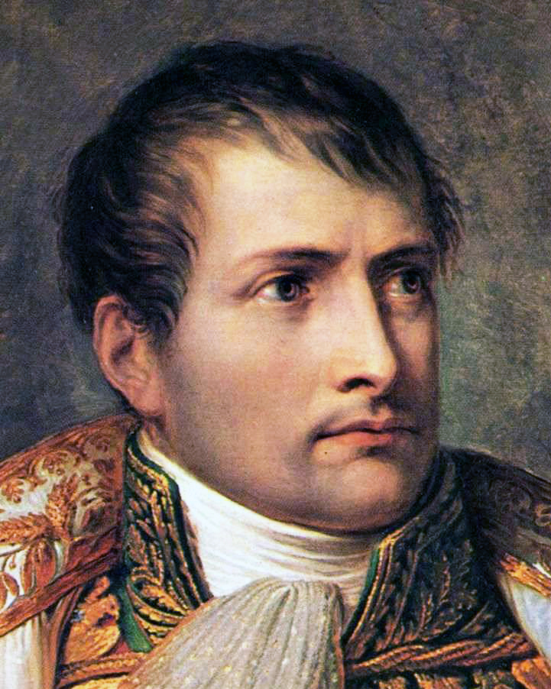
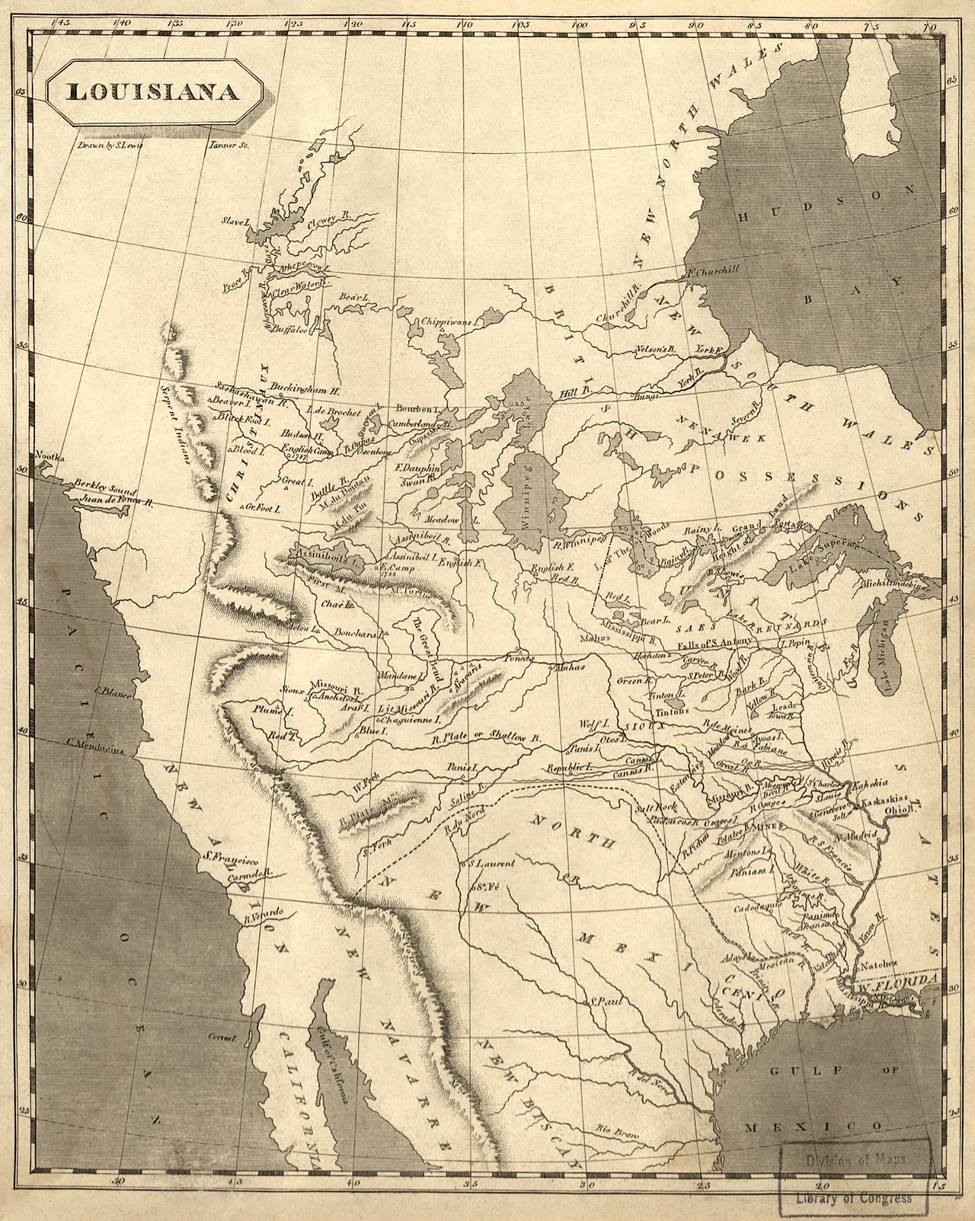
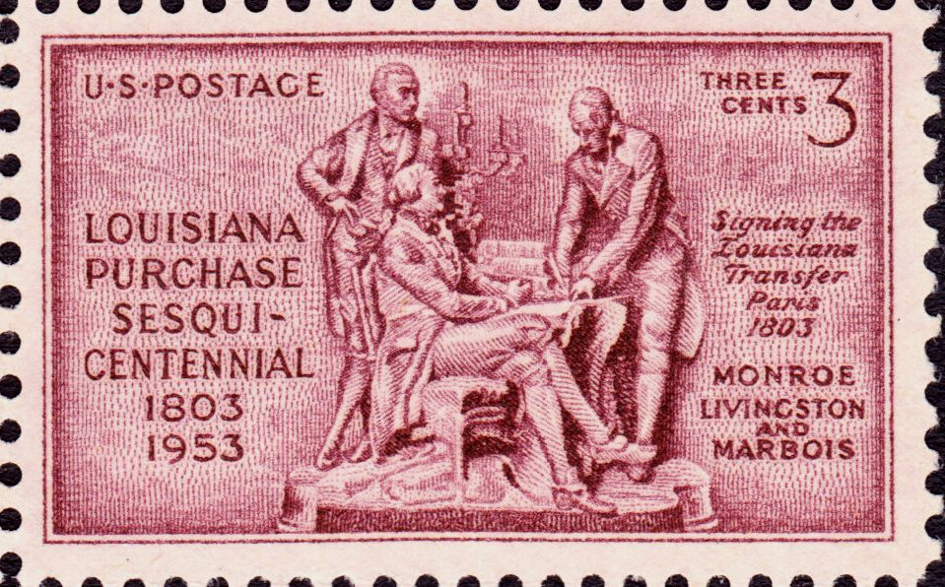
The Louisiana Purchase
In 1800, Napoleon forced Spain to give the Louisiana Territory back to France.
Previously, Americans had been able to use the port of New Orleans. This was important to American farmers who sent their crops down the Mississippi River into the Gulf of Mexico. This right was threatened once France controlled New Orleans.
Napoleon Bonaparte

Slide 17
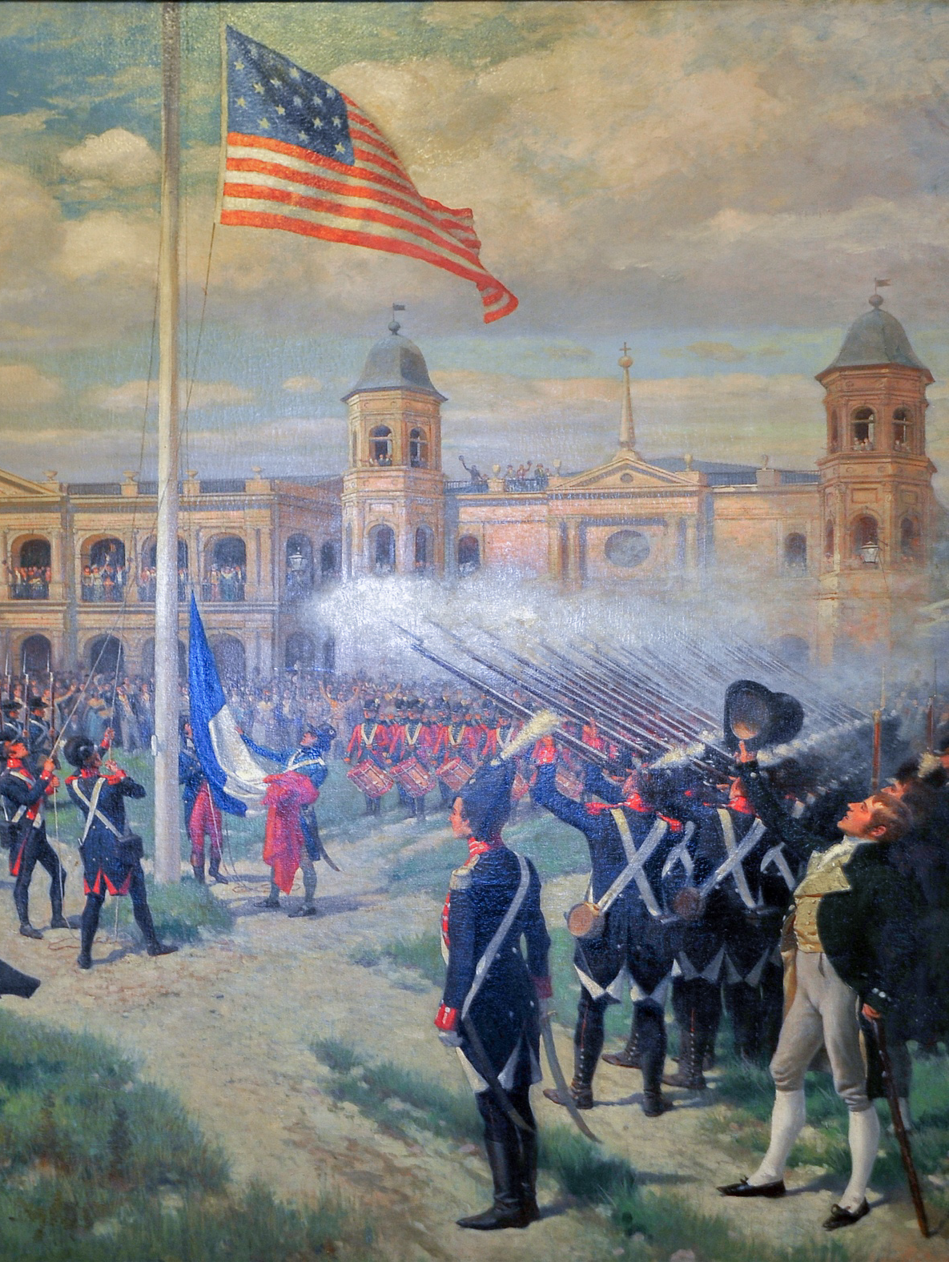
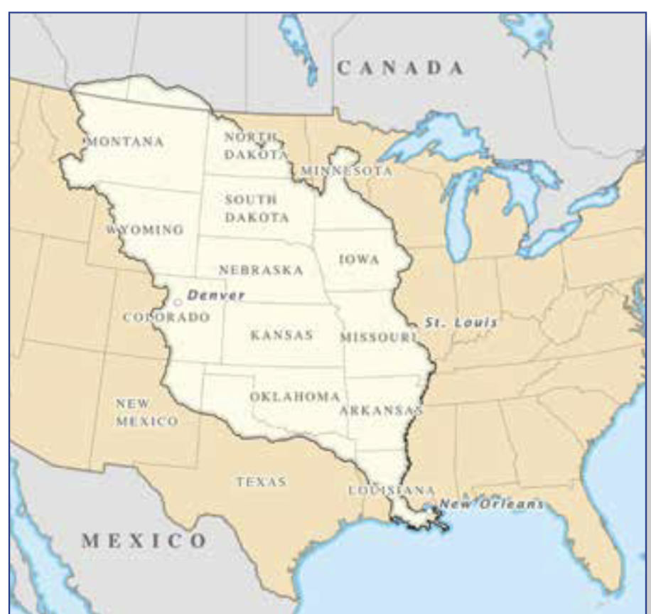
The Louisiana Purchase
Jefferson sent negotiators to Paris to purchase New Orleans. Napoleon surprisingly offered the entire Louisiana Territory to the United States for $15 million. Jefferson immediately agreed.
Nonetheless, Jefferson did not believe the Constitution actually gave him the authority to make the purchase. He would have preferred a constitutional amendment to authorize the sale.
The Louisiana Territory
Flag raising in the Place d'Armes (now Jackson Square), New Orleans

Slide 18
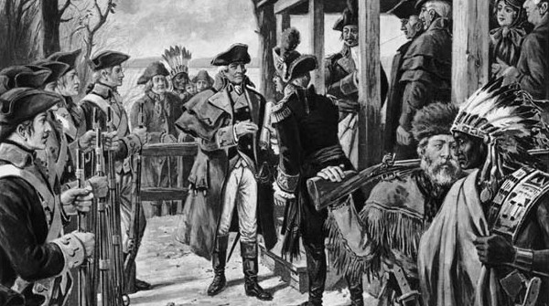
Transfer of Louisiana by Ford P. Kaiser
The Louisiana Purchase doubled the size of the United States, ended French claims to North America, and allowed Americans to further pursue westward expansion.

Slide 19
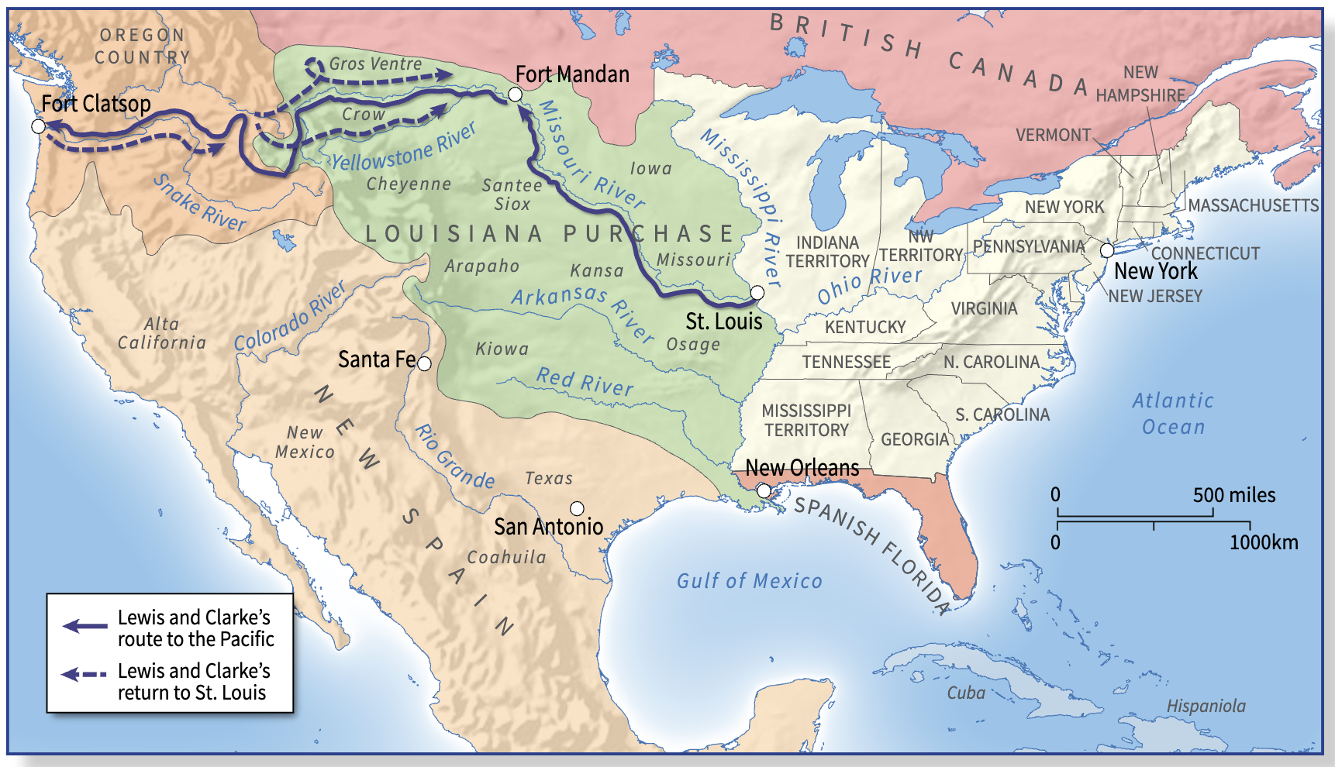
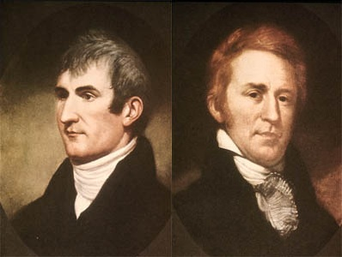
The Lewis and Clark Expedition (1804–1806)
Jefferson sent Meriwether Lewis and William Clark to explore the new territory. He asked them to collect information about its geography, Indian tribes, and plant and wildlife.
Lewis and Clark

Slide 20
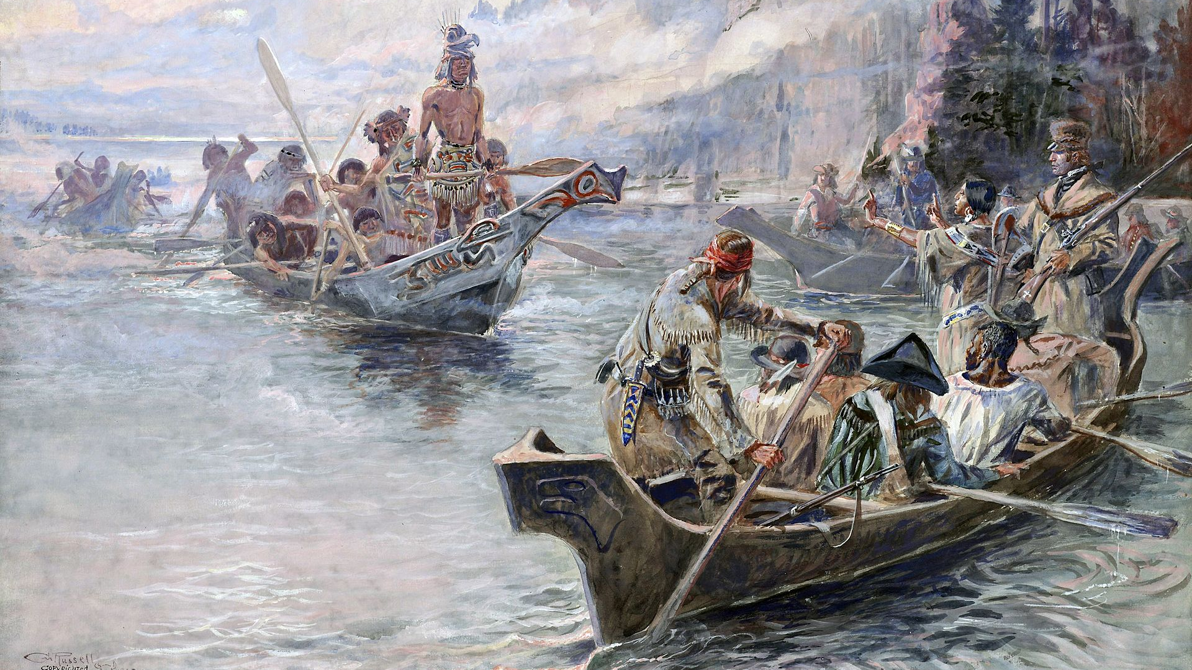
The Lewis and Clark Expedition (1804–1806)

Slide 21
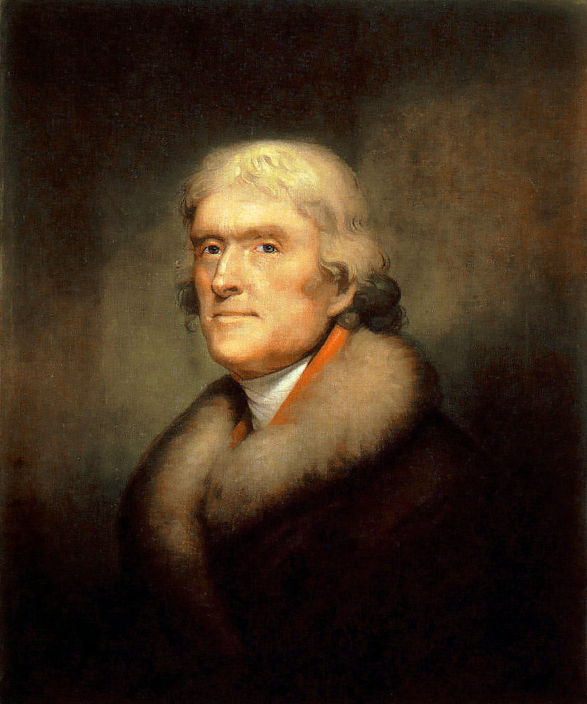
Jefferson’s Second Term: Economic Warfare in Europe
Economic warfare between France and Britain placed American merchants in a difficult situation. Jefferson did not want war and pushed the Embargo Act of 1807 through Congress.
This law prohibited Americans from exporting goods to foreign countries until Britain and France lifted their restrictions on neutral shipping. It hurt Americans more than foreigners and was unpopular.
Thomas Jefferson

Slide 22
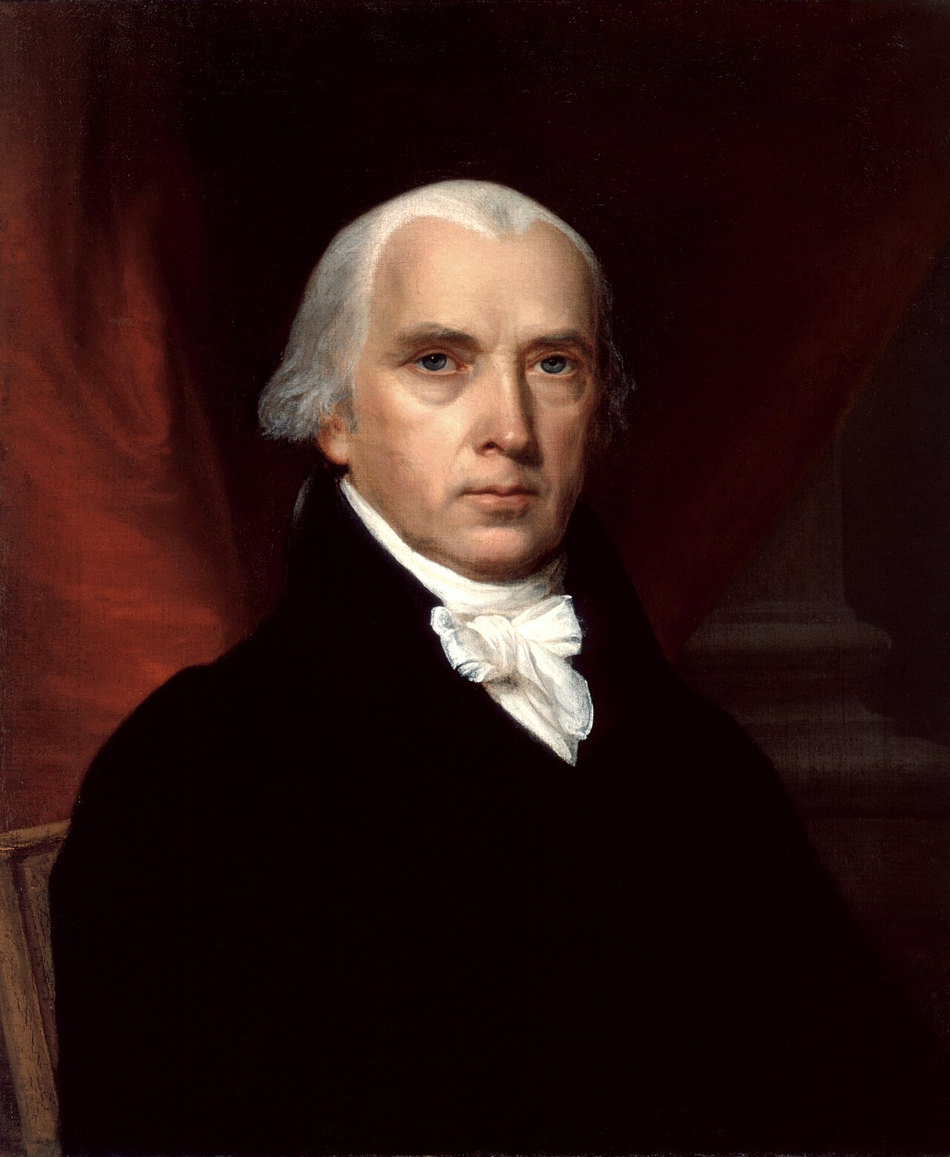
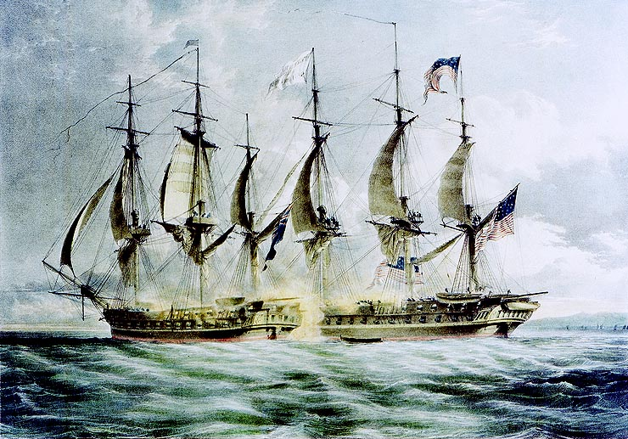

The Presidency of James Madison and the War of 1812
James Madison was elected President in 1808. Tensions with Britain were high. British officers were supplying guns to Indian tribes in the Northwest, who attacked American settlers.
The British navy was stopping American ships on the high seas to search for British deserters. The “war hawks” in Congress pushed for war so that Americans could seize Canada.
Congress finally declared war on Britain, starting the War of 1812.
James Madison

Slide 23
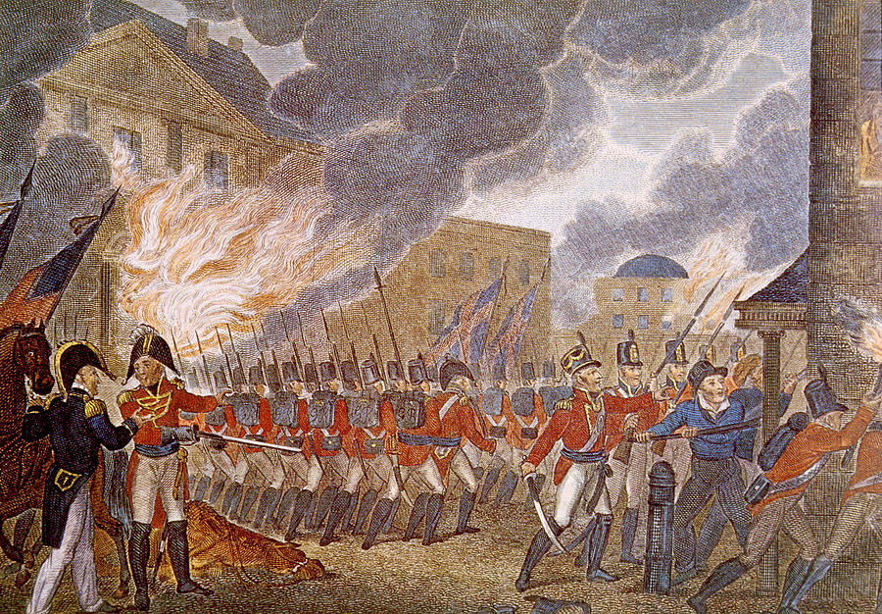
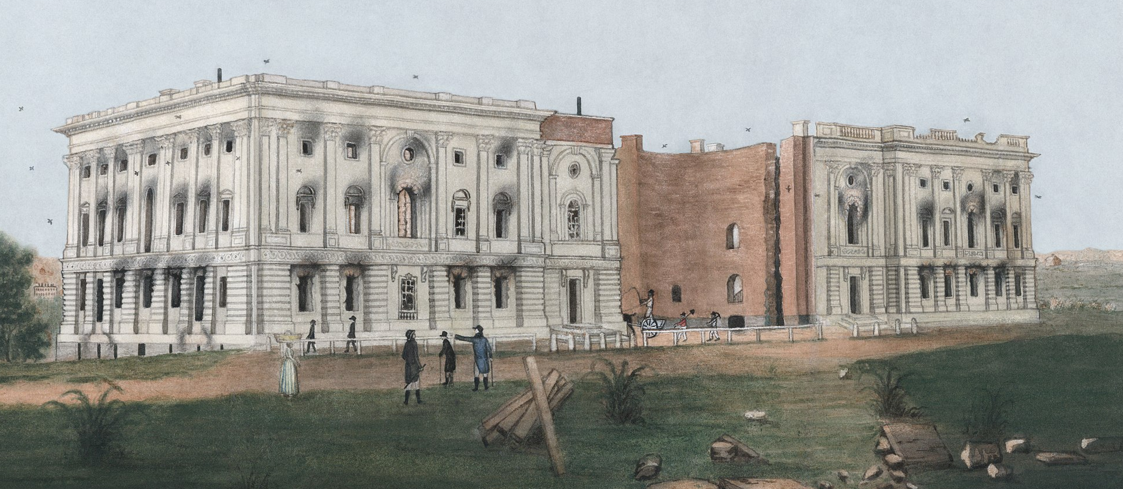
Course of the War
American attempts to invade Canada failed. A British force landed in Chesapeake Bay, occupied Washington, D.C., and burned public buildings, including the White House. British ships bombarded Fort McHenry in Baltimore but could not take the fort.
Francis Scott Key wrote “The Star-Spangled Banner,” our national anthem. American manufacturers benefited when Americans could no longer buy British goods.

Slide 24
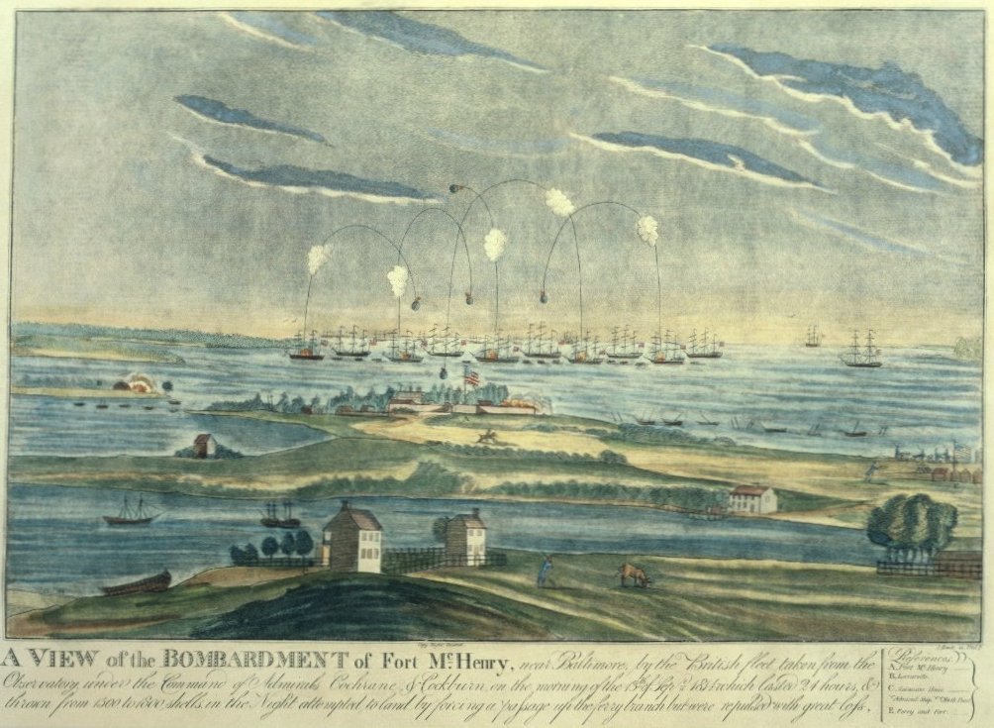

Slide 25
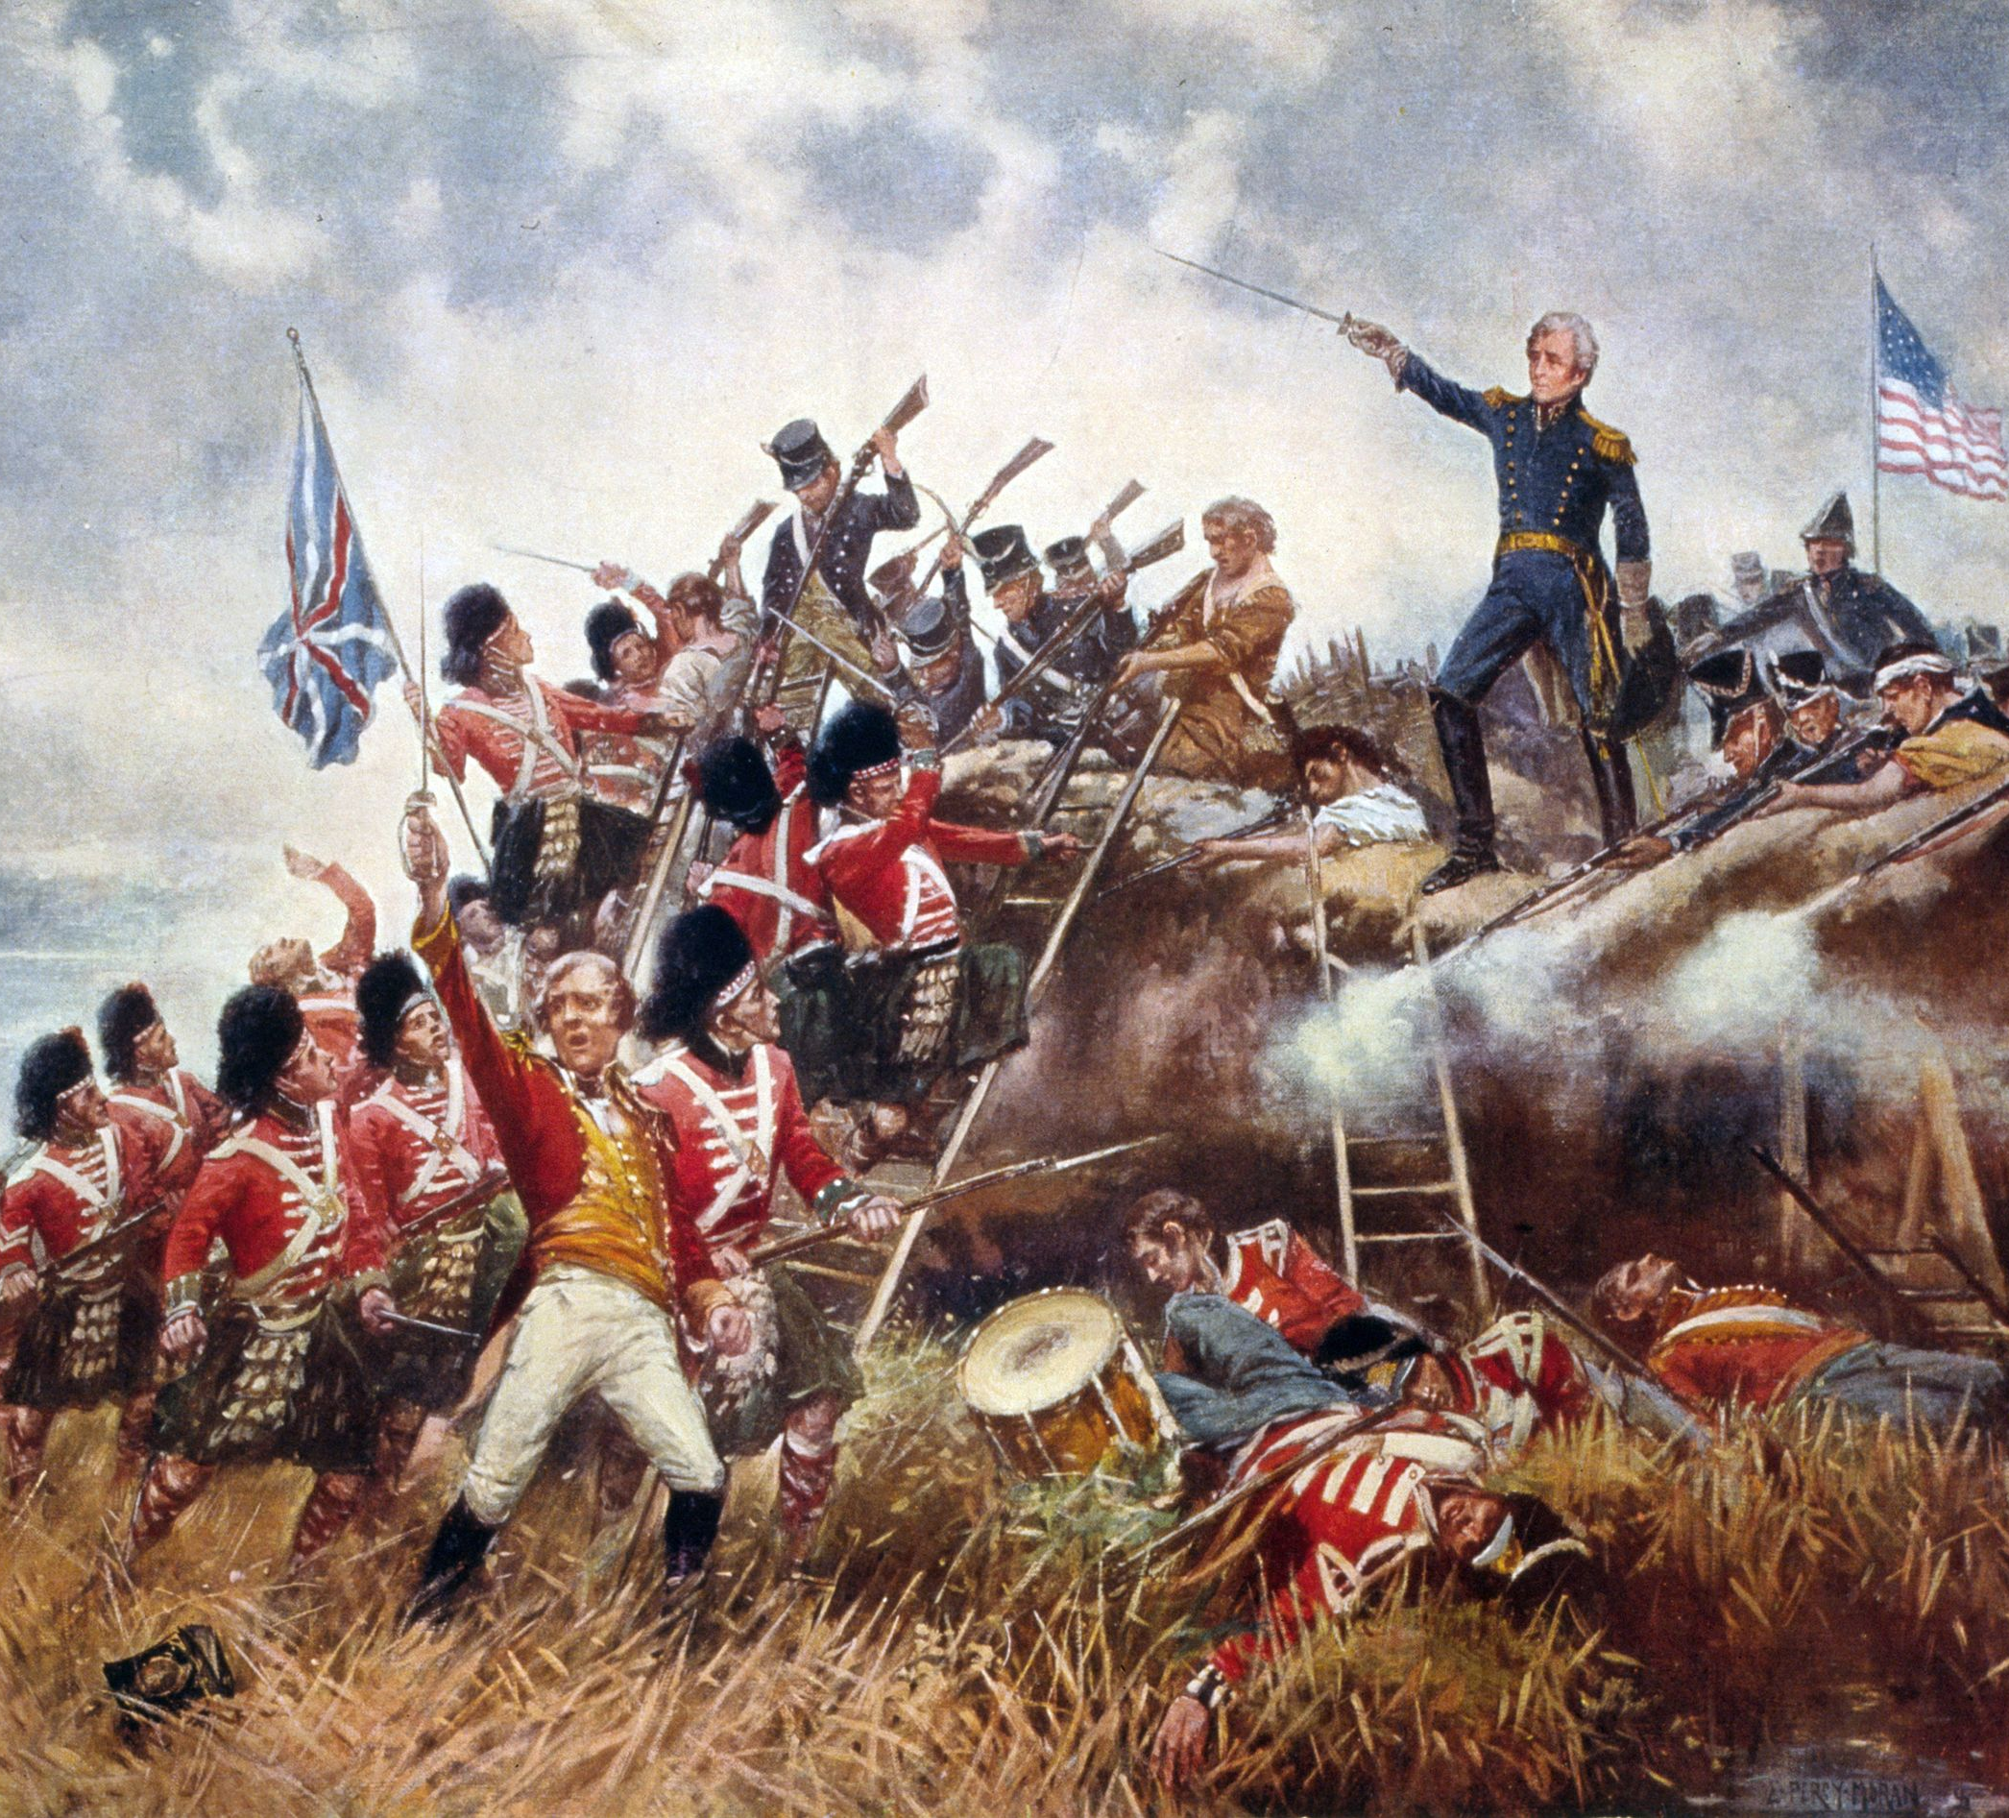
The War Comes to an End
America and Britain signed a treaty ending the war in December 1814. News of the treaty had not reached America when British troops attacked New Orleans.
Andrew Jackson became a hero after defeating the attack. The war contributed to Americans’ sense of national identity.
Battle of New Orleans

Slide 26
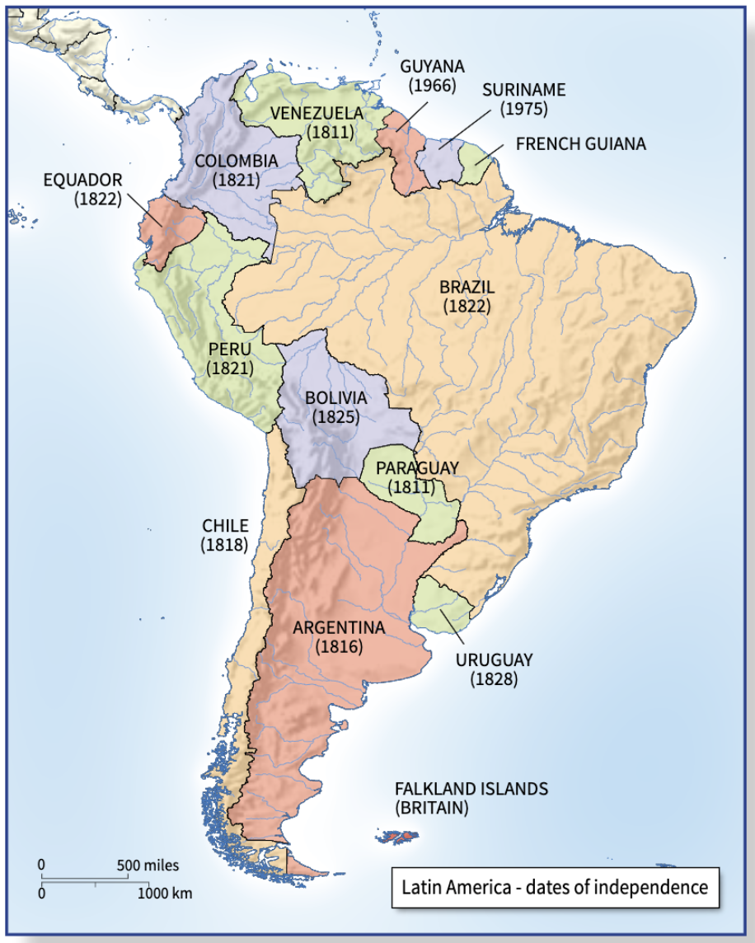
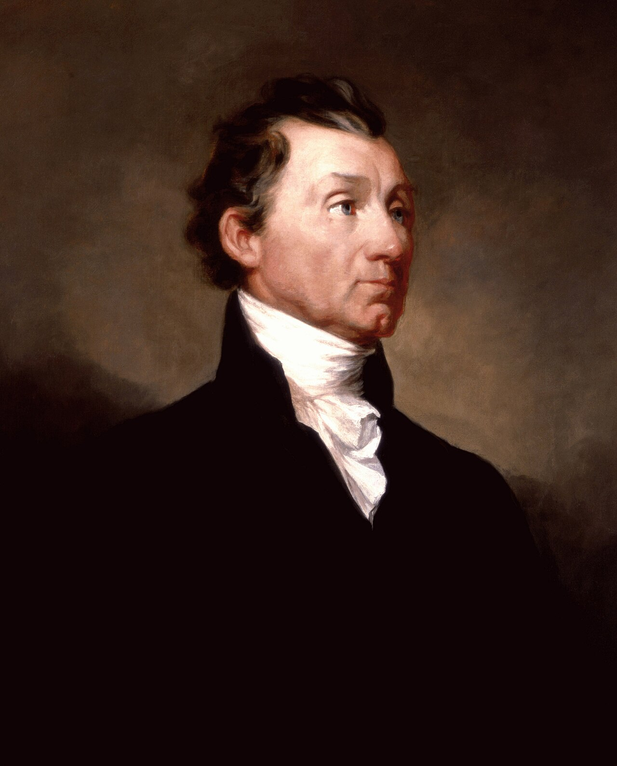
The Presidency of James Monroe and the Monroe Doctrine
James Monroe was elected President in 1816. He issued the Monroe Doctrine in 1823. This announced that the United States would not allow European powers to start new colonies or to restore rule over former ones that had achieved independence.
James Monroe

